Slide 1

Finance Management System
Object-Oriented-Design
Spring Group 5
Github Link:
https://github.com/NavinKankarwal/CSCI_6234_OOD_Project
Team Members:
Navin Kankarwal
Akash Ashok
Ritu Kale

Slide 2
Object-Oriented-Design
1.
Project Vision
Requirements Modeling: Use Cases and Activity Diagrams
2.
3.
Analysis Model: Robustness Diagrams
Architectural Model: Package and Component Diagrams
4.
Design Model: Class, Sequence, and State Diagrams
5.

Slide 3
Project Vision: Finance Management System
The Finance Management System enables individuals to efficiently monitor income and expenses, analyze spending patterns, and improve financial management through an intuitive interface. It allows users to record, categorize, and track expenses on the go, providing insights and reports to help them stay within budgets, save for goals, and make informed financial decisions—all while ensuring data security through encryption and secure logins.

Slide 4
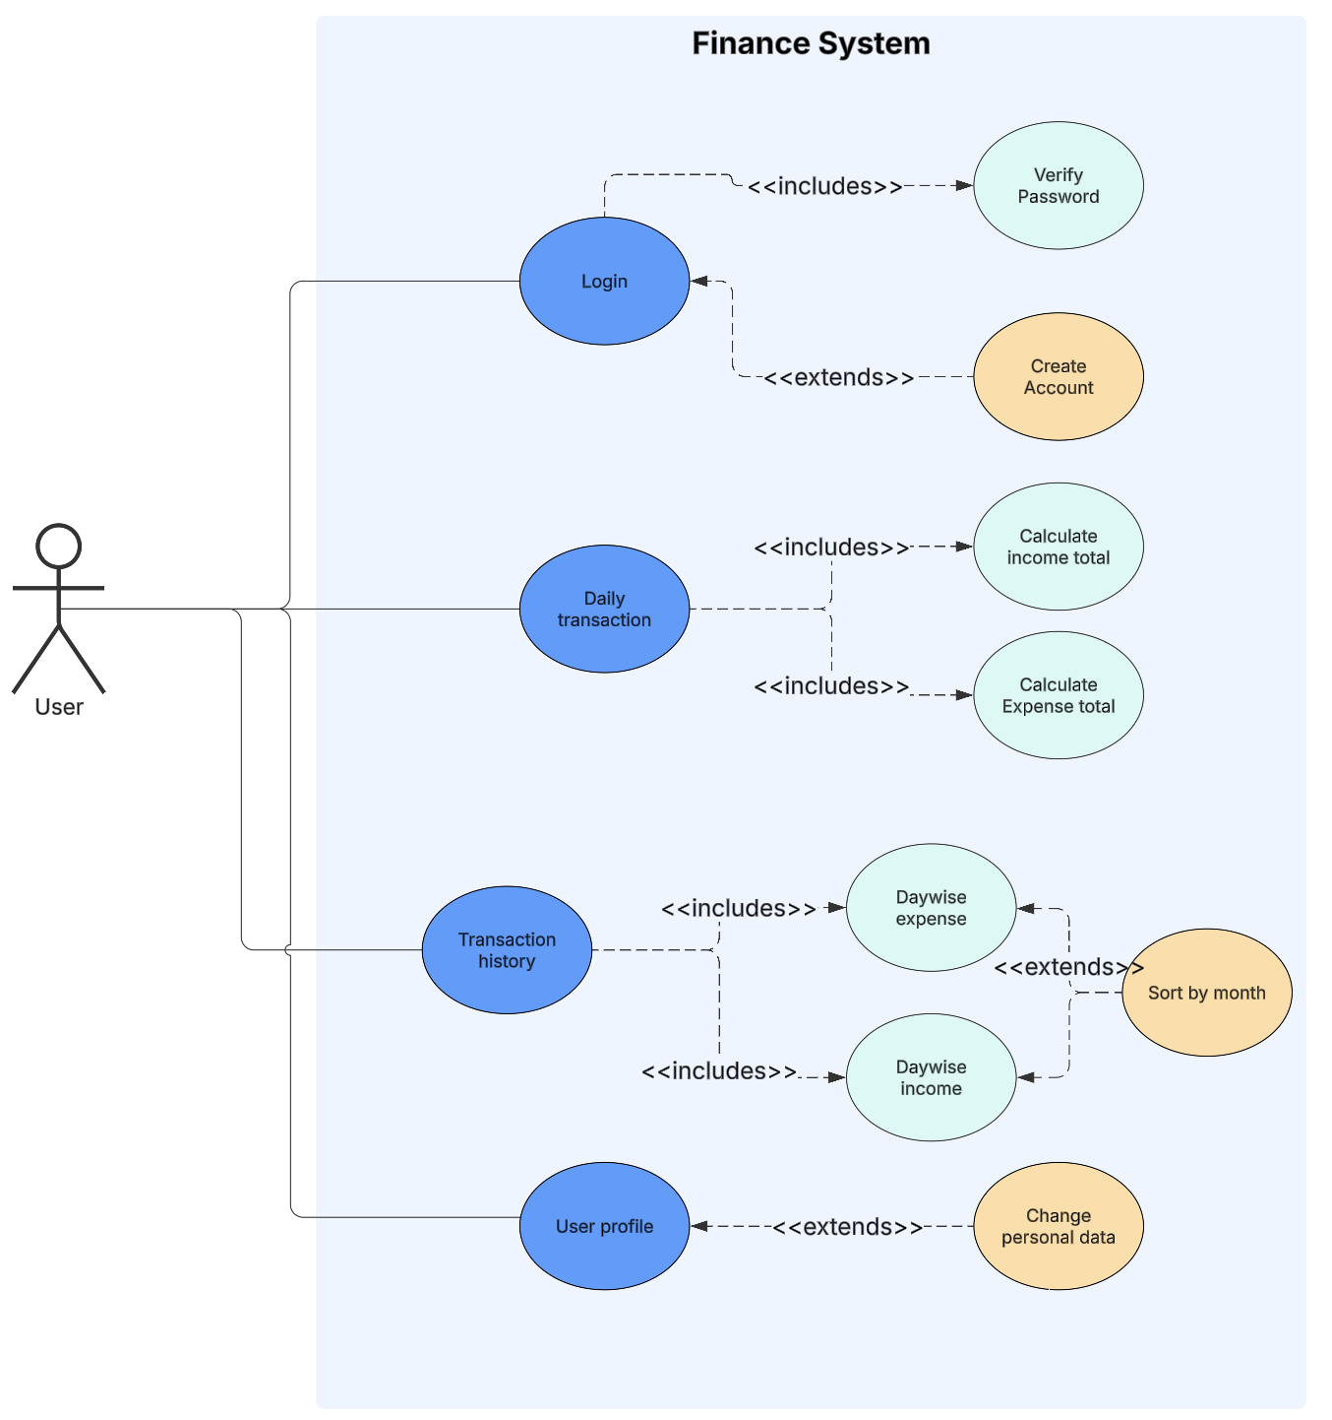
Use Case Diagram
Actors and Use Cases
Actors
User – Manages financial transactions, views history, and updates profile.
Use Cases
Log In – User enters credentials to access the system; can create an account if new.
Daily Transaction – User logs income and expenses; system calculates and updates totals.
Transaction History – Displays past transactions with categorized income and expenses.
User Profile – Allows users to view and update personal details like name and email.

Slide 5
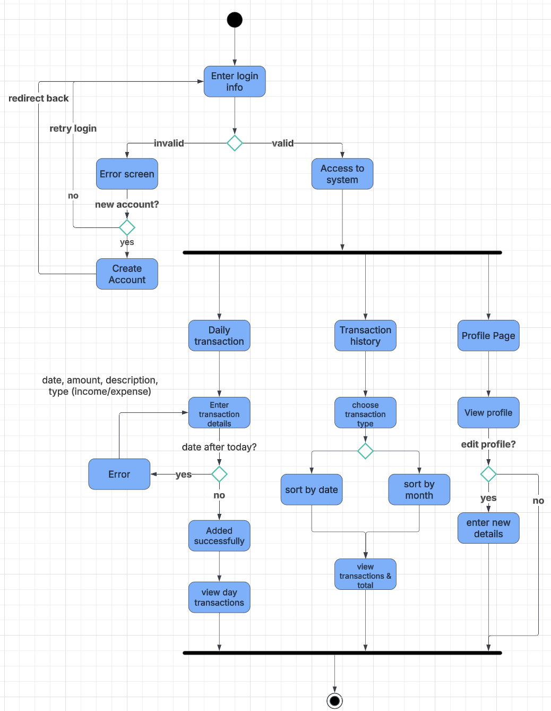
Activity Diagram

Slide 6
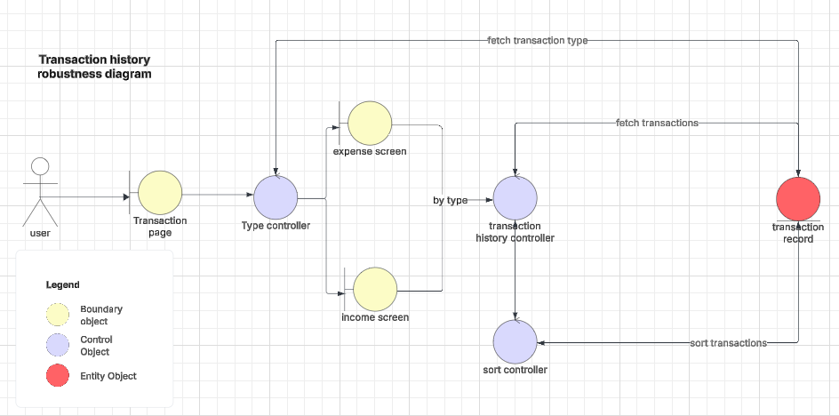
Robustness Diagrams

Slide 7
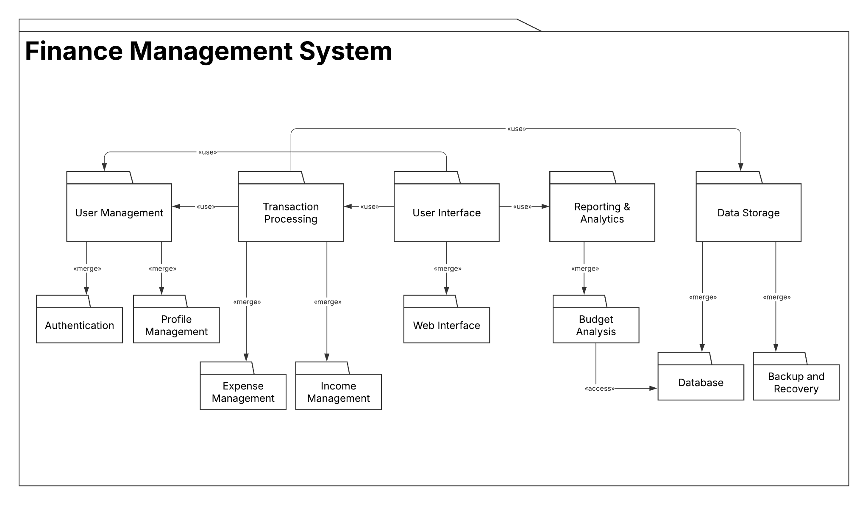
Package Diagram

Slide 8
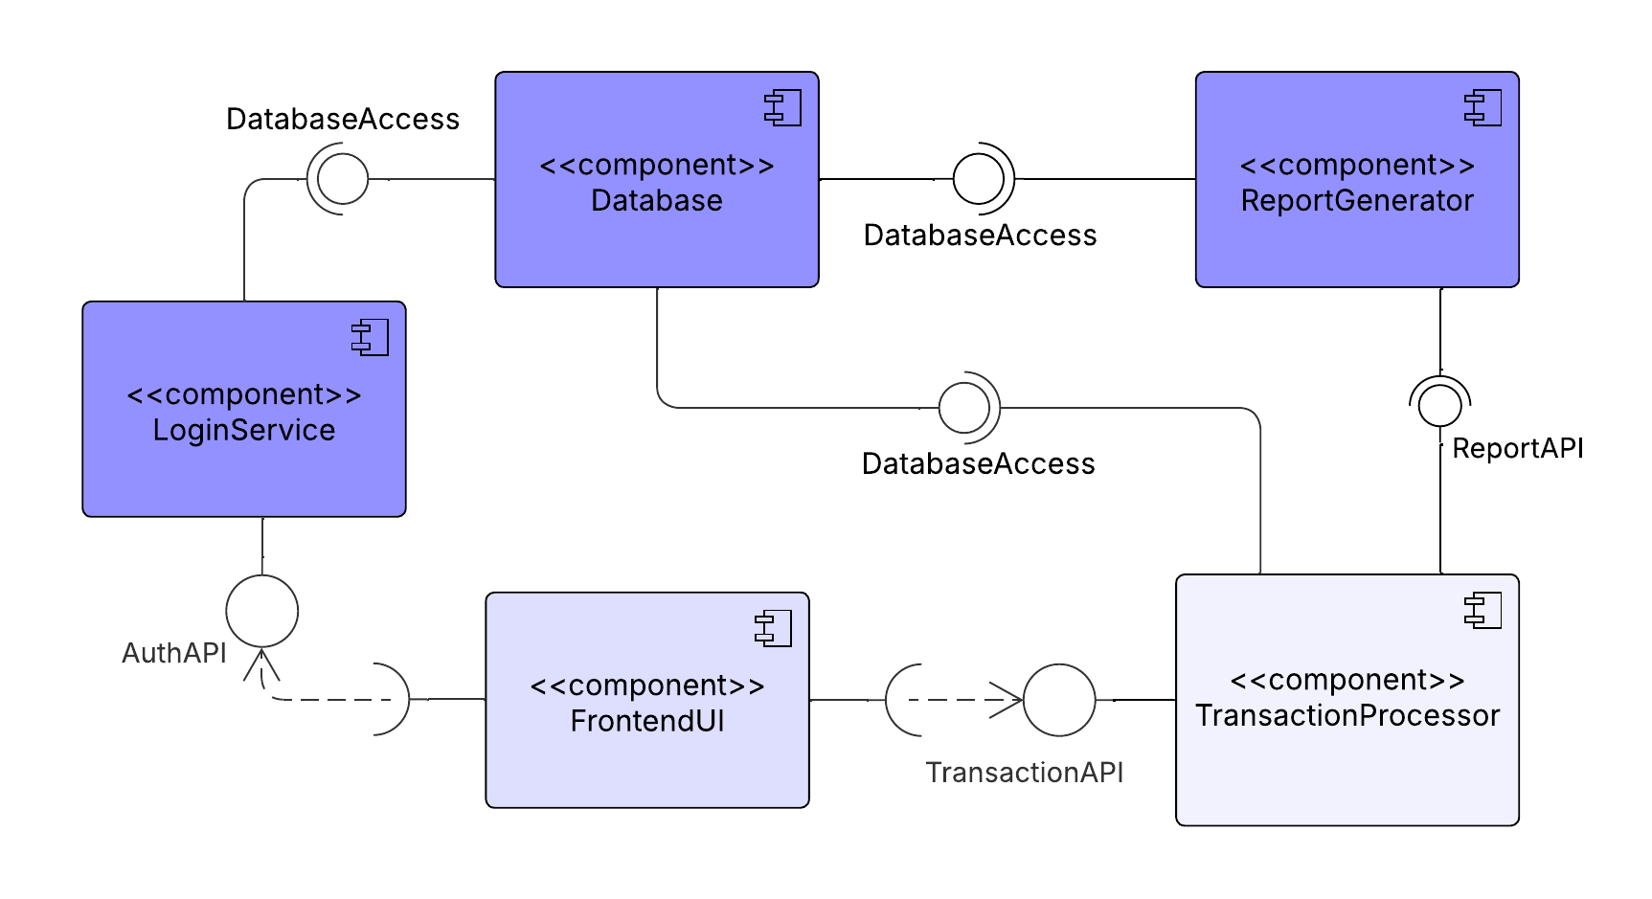
Component Diagram

Slide 9
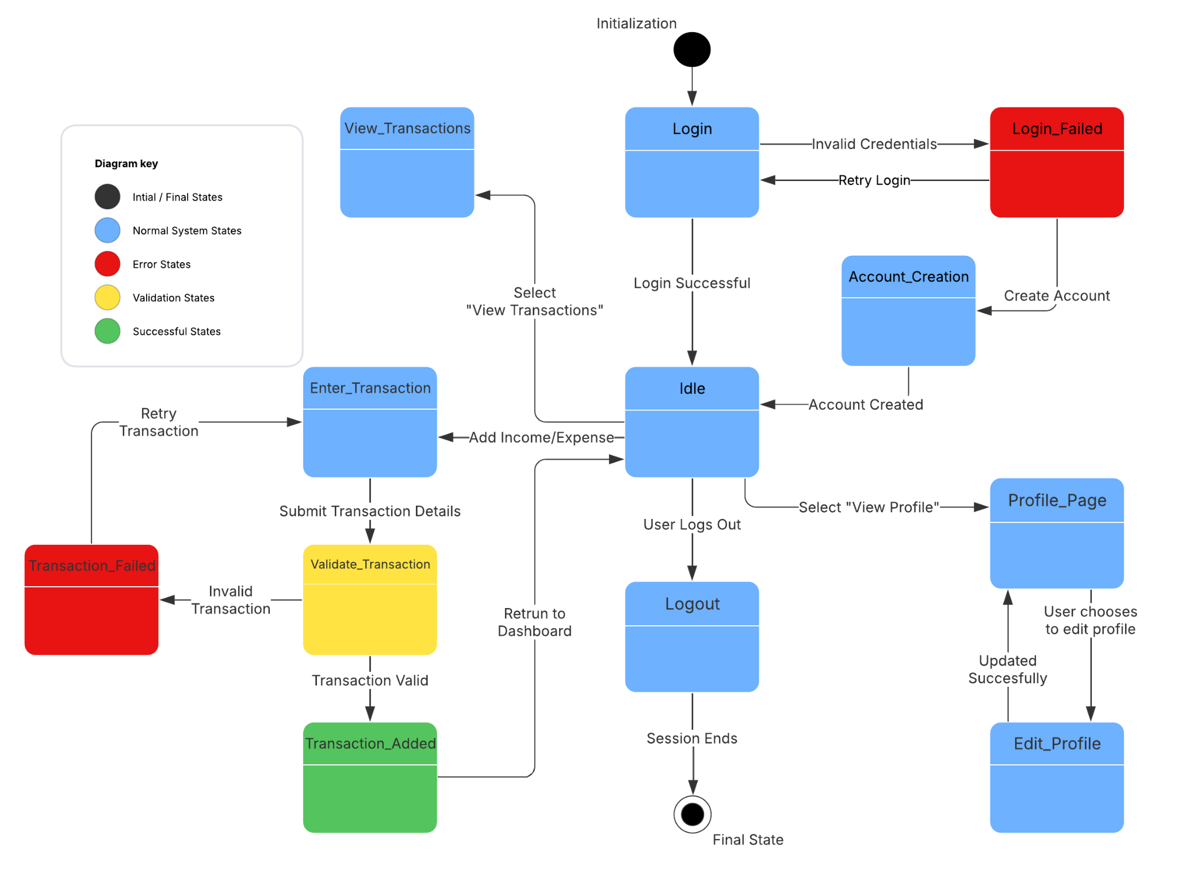
State Diagram

Slide 10
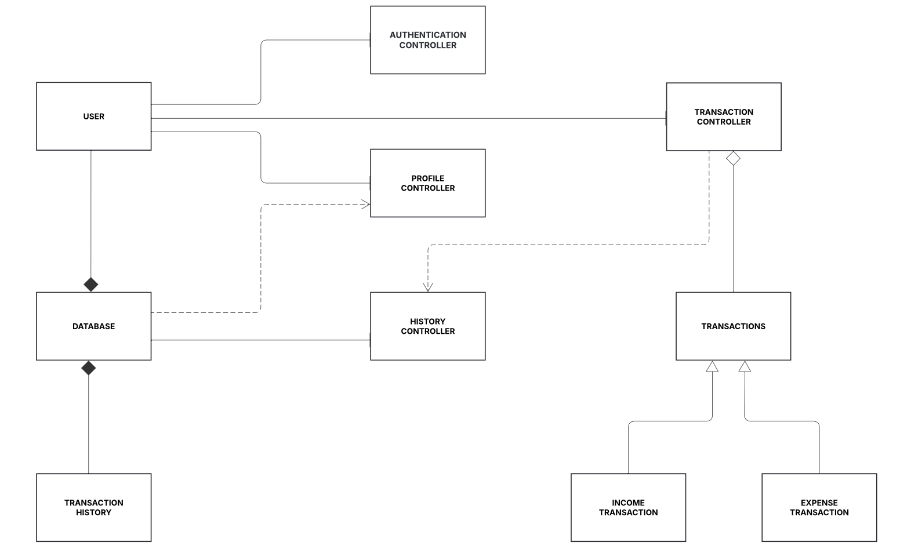
Class Diagram

Slide 11
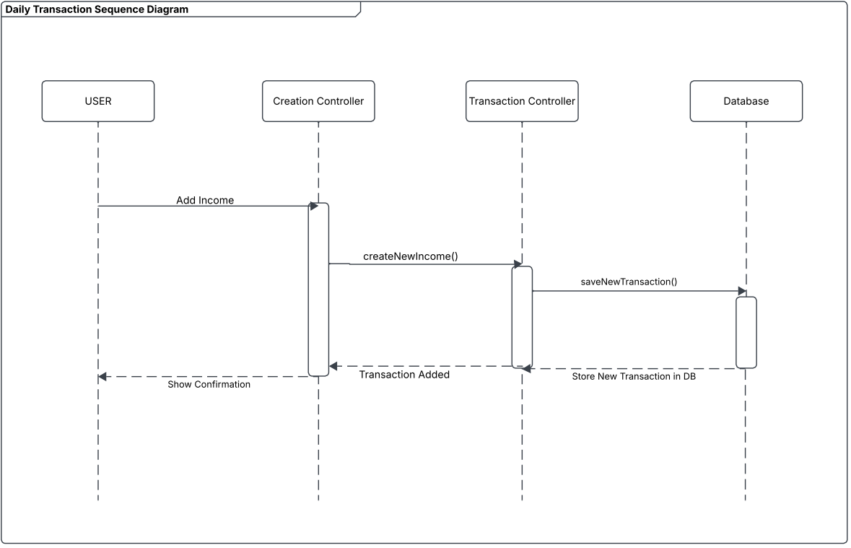
Sequence Diagram
Sequence Diagram for Handling Transaction
This diagram illustrates how a user adds an income transaction:
User selects "Add Income."
CreationController calls createNewTransaction().
TransactionController processes and saves data.
Database stores the transaction.
CreationController confirms success.
Ensures smooth transaction processing and accurate record-keeping.

Slide 12
Thank you

